Slide 1
B & B
Bed and breakfast…..
Presented By
Team : Code Ninja’s

Slide 2
Code Ninjas
Riyamol Sara Jayan
Jagan
Nithin mp
Minnu Augustine
Aditya Vaka
Ananthakrishnan

Slide 3

Description
B&B is an app that facilitates college students to book their hostel rooms.
This app will provide the complete details of the hostel room.
Through B&B App, it will be easier for the students to have a complete overview of the room beforehand.
Students can choose their room based on ratings and other features.

Slide 4

Our Features
Room Type
Room facility
Room Rent
Food Type and Rate
Location

Slide 5

Modules
Admin module
Hostel owner module
Student module

Slide 6

ADMIN module
Will have the provision to control and monitor the activities of both students and hostel owners.
Validation of hostel owners is done by the admin.

Slide 7
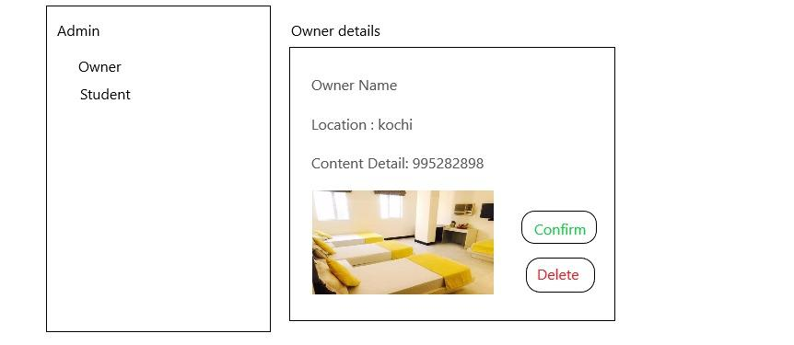

Slide 8
2. HOSTEL OWNER module
Different pages for hostel owner are:
Registration page(sign up)
Login page(sign in)
Create hostel page

Slide 9
Hostel Owner - Registration
Owner will have to fill the fields mentioned below in Registration page -
Name
User name
Password
email id
phone number
Registration document of hostel

Slide 10

Hostel Owner - Login page
After successful registration hostal owner can now able to login using,
Username
password

Slide 11
Hostel Owner - Create hostel page
Name
Room details - type
Number of vacant rooms
Location
Rate
Contact details
Upload images of his hostel

Slide 12

3 STUDENT Module
Different pages for students are:
Student registration page(sign up)
Student login page(sign in)
Hostal details page

Slide 13
Students - Registration Page
Student will need to provide
Student Name
E-mail ID
College Name
Course Name
Username
Password

Slide 14
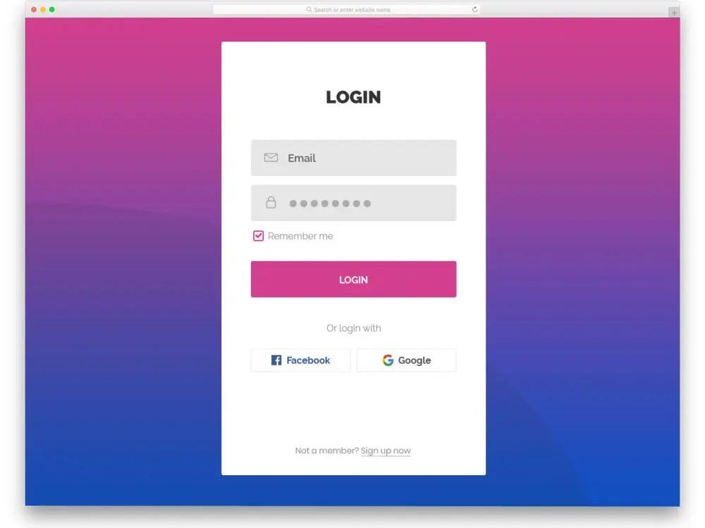
Student - Login Page
After successful registration, student can login with their username and password

Slide 15
Hostel details page
This page
Displays the list of hostels
Then on selecting a hostel
displays the details of that particular hostel - owner details, room types, contact info, rate etc.
Student can contact the respective hostal owner by phone

Slide 16
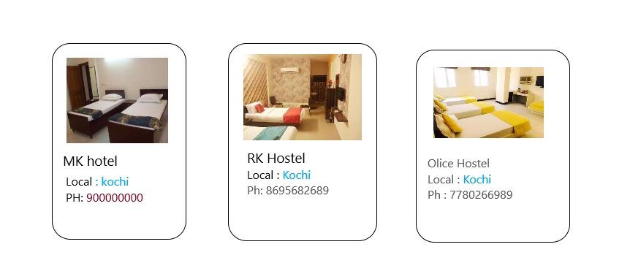

Slide 17
Pages
Home page / Login page
Registration Page - owner & student registration
Hostal creation page
Page with details of hostel

Slide 18
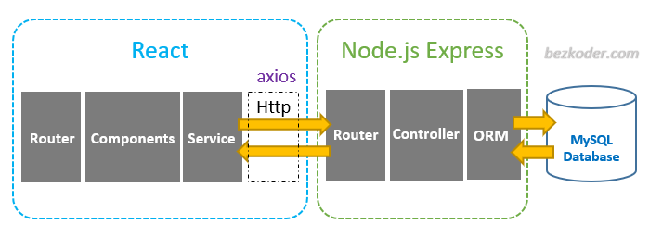
Technologies Used
React - Frontend
Node JS - Backend
MySQL - DB

Slide 19

THANK YOU

